Slide 1

InsurAI – Corporate Policy Automation and Intelligence System
Transforming corporate insurance management through intelligent automation
Presented by: Vedha Kavya Sudha Perni | Infosys Internship

Slide 2

The Challenge: Manual Insurance Operations
Corporate insurance policy management remains a complex, manual process that creates significant operational bottlenecks. Organizations struggle with workflows that depend heavily on human intervention for policy creation, claim settlement, compliance verification, and reporting.

Slide 3
Introducing InsurAI
InsurAI is a web-based intelligent platform that revolutionizes corporate insurance processes by combining AI-powered automation with modern web technologies. The system delivers a seamless, responsive experience with support for both dark and light modes.
Core Purpose
User Roles
Automate policy creation, management, and claims processing
👤 User
🧑‍💼 Admin
Oversee users, policies, and claims with comprehensive dashboards and analytics
Simplify verification through AI and expert validation workflows
Manage policies, file claims, and verify documents with ease
Deliver an intuitive, responsive user experience
Provide real-time insights and analytics

Slide 4
Strategic Objectives
01
02
03
Build Secure Infrastructure
Enable Real-Time Insights
Automate Core Processes
Develop a robust, intelligent corporate policy system with enterprise-grade security and authentication
Provide dynamic dashboards for both users and administrators with actionable analytics
Streamline policy verification and claim tracking through intelligent automation
04
05
Enhance User Support
Ensure Scalability
Integrate intelligent chatbot assistance for instant help and navigation guidance
Design for future cloud deployment to support growing business needs

Slide 5







Core Features – MVP Scope
Authentication
Dashboard
Policy Management
User and admin registration with JWT-based login and secure password encryption using industry-standard protocols
Personalized views displaying policy statistics, recent activities, and key performance metrics
Complete policy lifecycle support with create, edit, view, and delete capabilities plus advanced filtering and sorting
Claims Management
Verification System
Admin Profile
Streamlined claim filing with document upload, real-time tracking, and status monitoring
Hybrid AI and expert validation workflow designed for future intelligent automation upgrades
Secure credential management allowing administrators to update personal details and security settings
Chatbot Assistant
Floating AI-powered assistant available on all pages for navigation help and frequently asked questions

Slide 6






Technology Stack
InsurAI leverages a robust, modern technology stack that balances performance, security, and user experience. Each layer has been carefully selected to ensure scalability and maintainability.
Frontend
React.js for component-based architecture, Tailwind CSS for responsive styling, Framer Motion
for smooth animations
Backend
Spring Boot framework with RESTful APIs for efficient, scalable service architecture
Database
MySQL relational database for robust data persistence and transaction management
Security
Spring Security with JWT token authentication and bcrypt password hashing
UX Enhancements
Dark/Light mode theming, fluid animations, and fully responsive design patterns

Slide 7
Development Milestones
1
Milestone 1: User Authentication
Implemented secure registration and login flows with JWT-based token authentication, session management, and logout functionality
2
Milestone 2: Policy Management
Built comprehensive policy CRUD operations with advanced search, filter, and sort capabilities. Established real-time data synchronization with backend APIs
3
Milestone 3: Admin Dashboard & Profiles
Created analytics-rich admin dashboard with user, policy, and claims metrics. Developed dynamic tables for application tracking and secure profile management with credential updates
4
Milestone 4: Claims & Support
Launched claim submission system with document upload, multi-stage status tracking (Submitted → Under Review → Approved/Rejected), and integrated AI chatbot for instant Q&A and navigation assistance

Slide 8
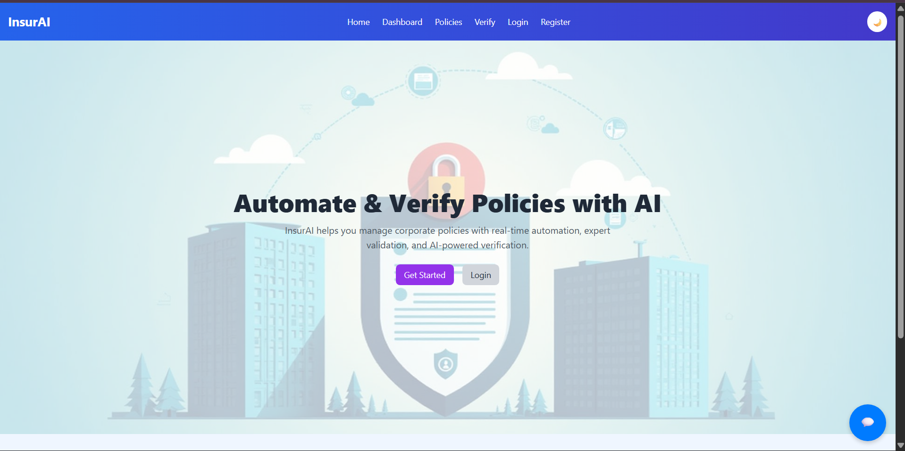
Project Snapshots

Slide 9
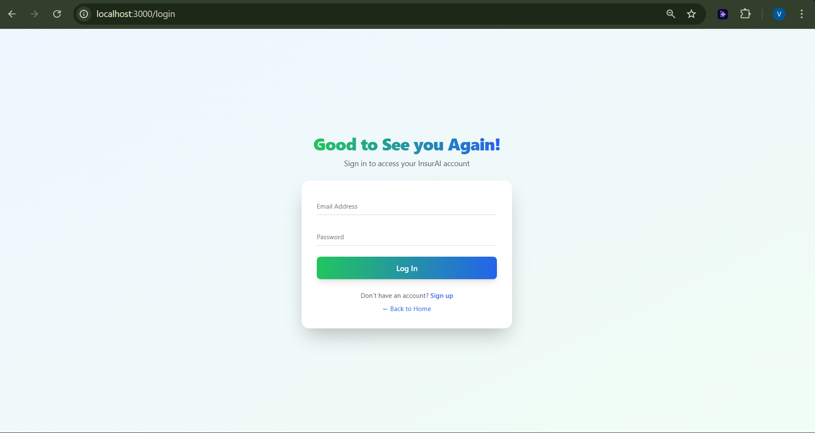
Login Page

Slide 10
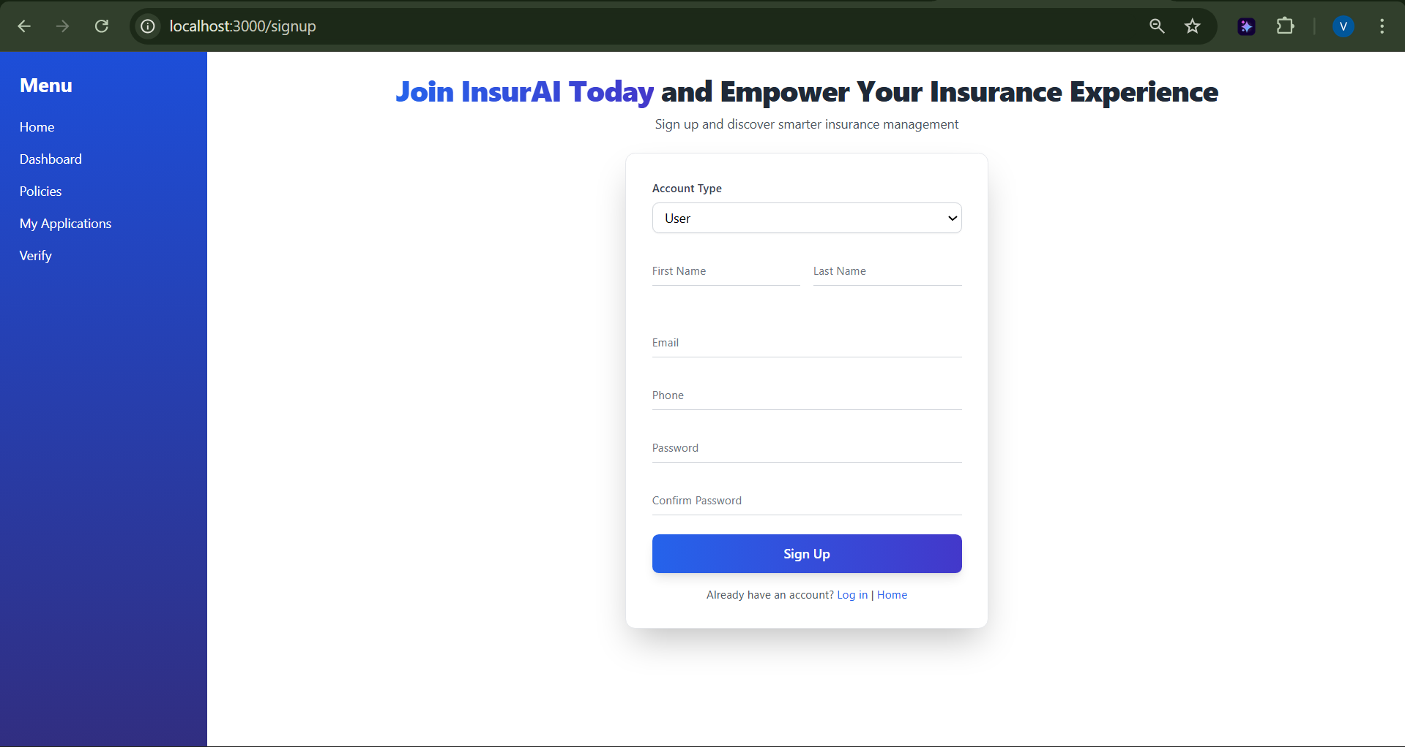
Registration Page

Slide 11
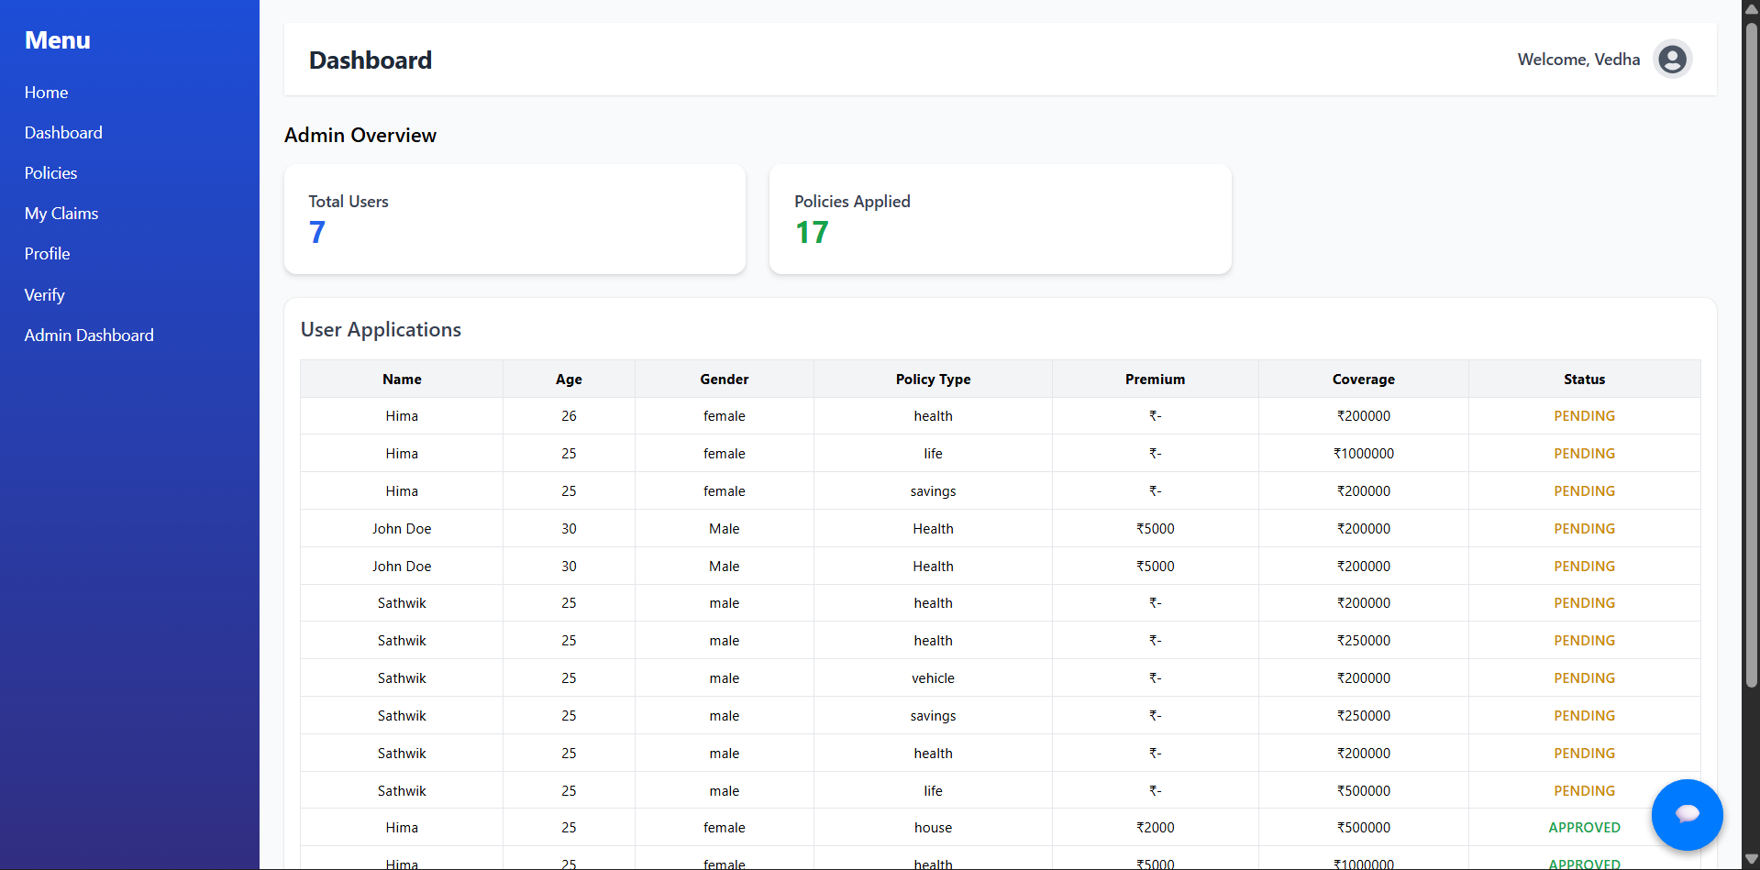
Admin Dashboard

Slide 12
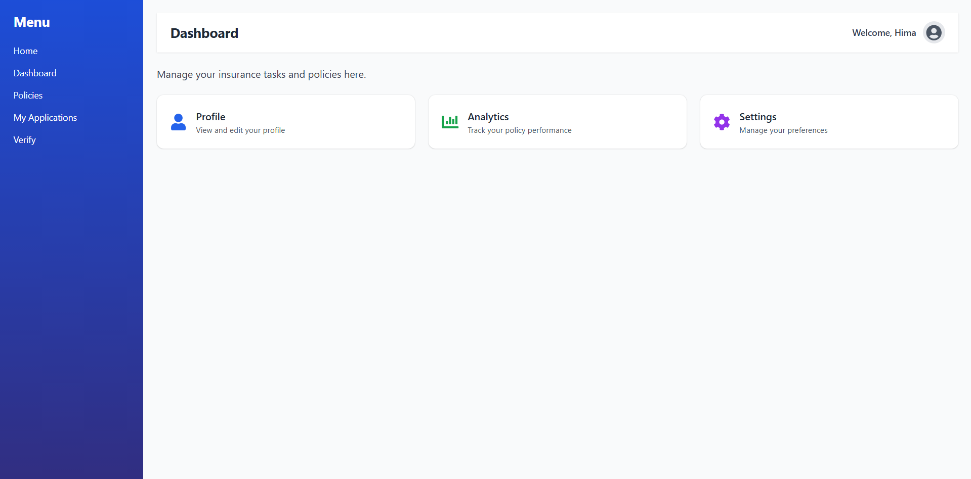
User Dashboard

Slide 13
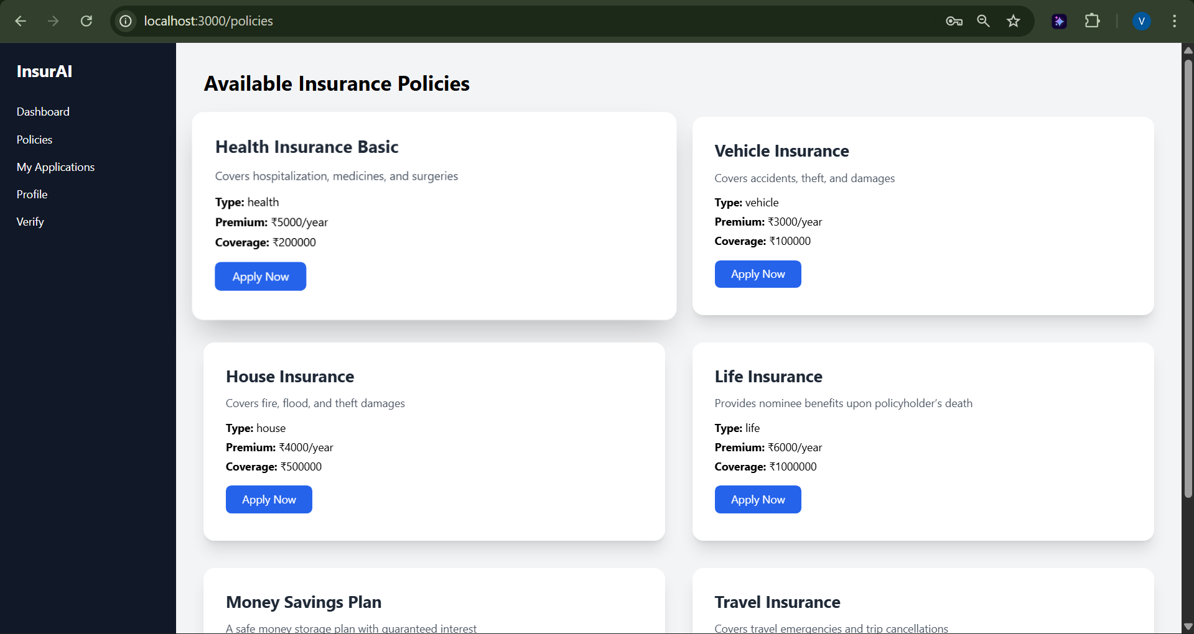
Policy Management Page

Slide 14
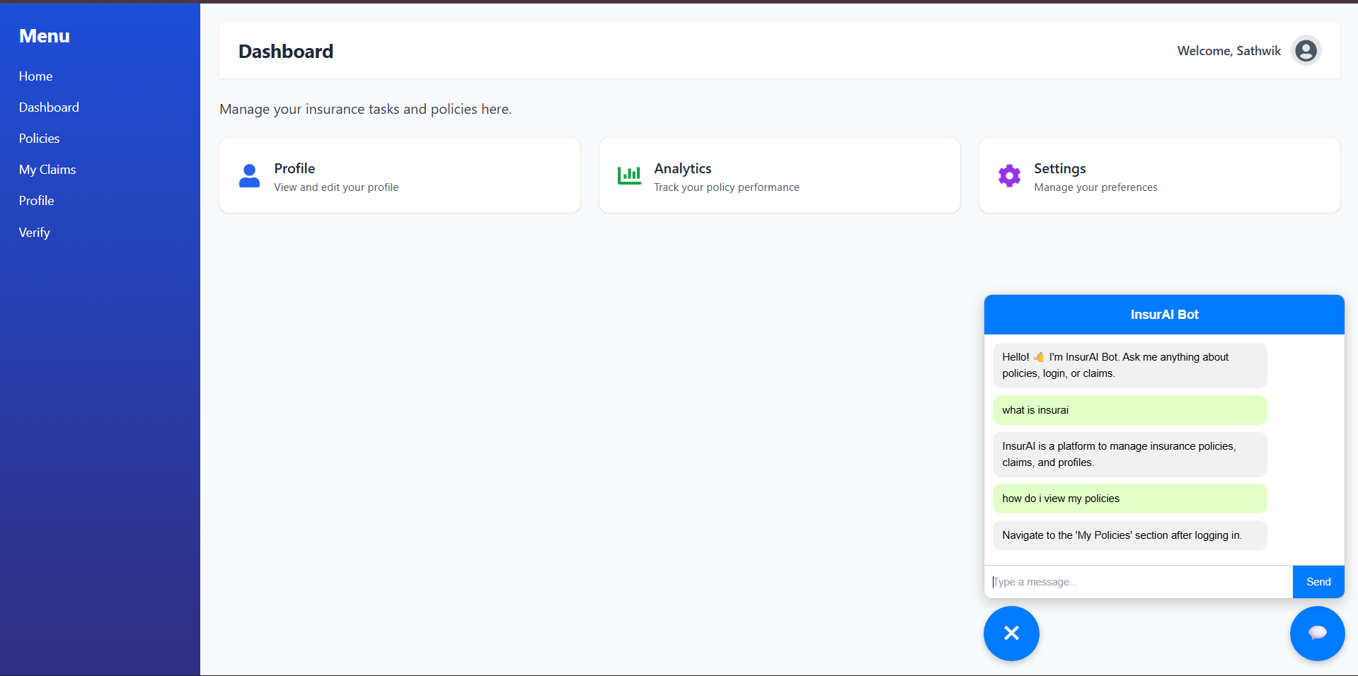
Chat Support

Slide 15
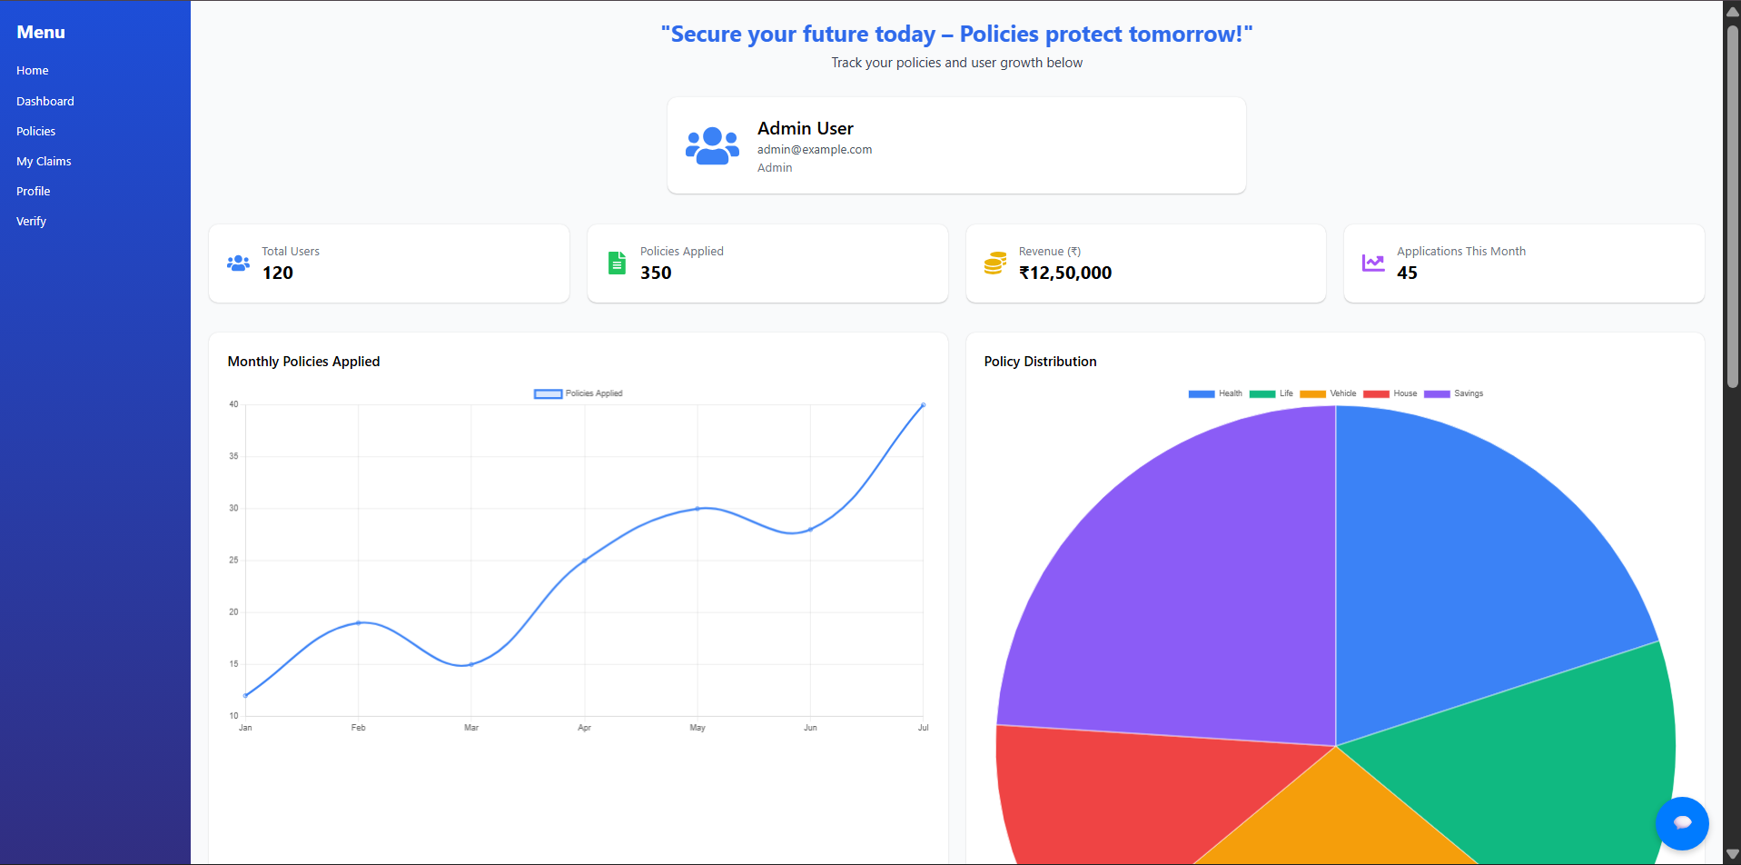
Admin Profile

Slide 16
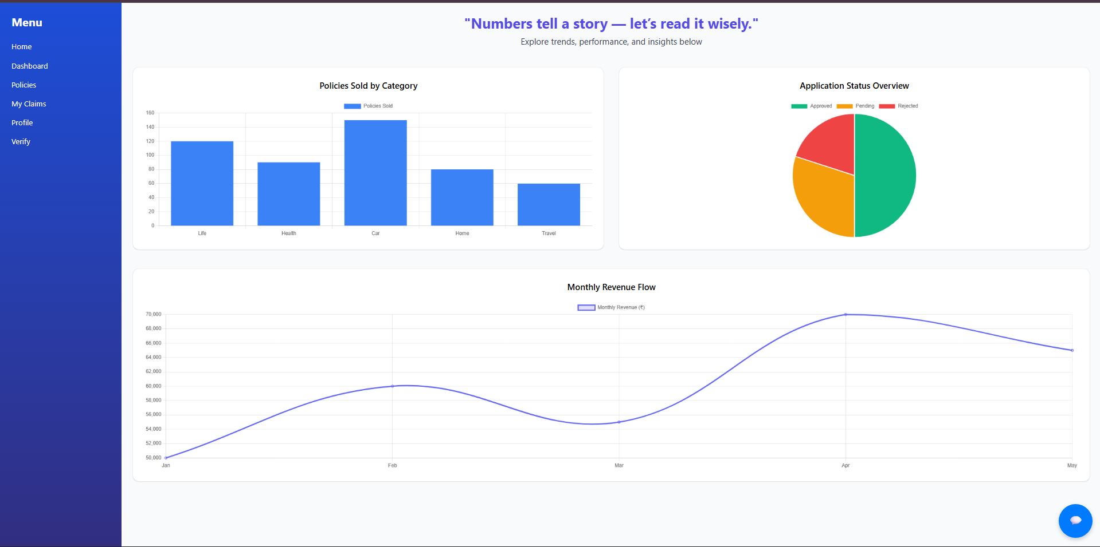
User Profile

Slide 17
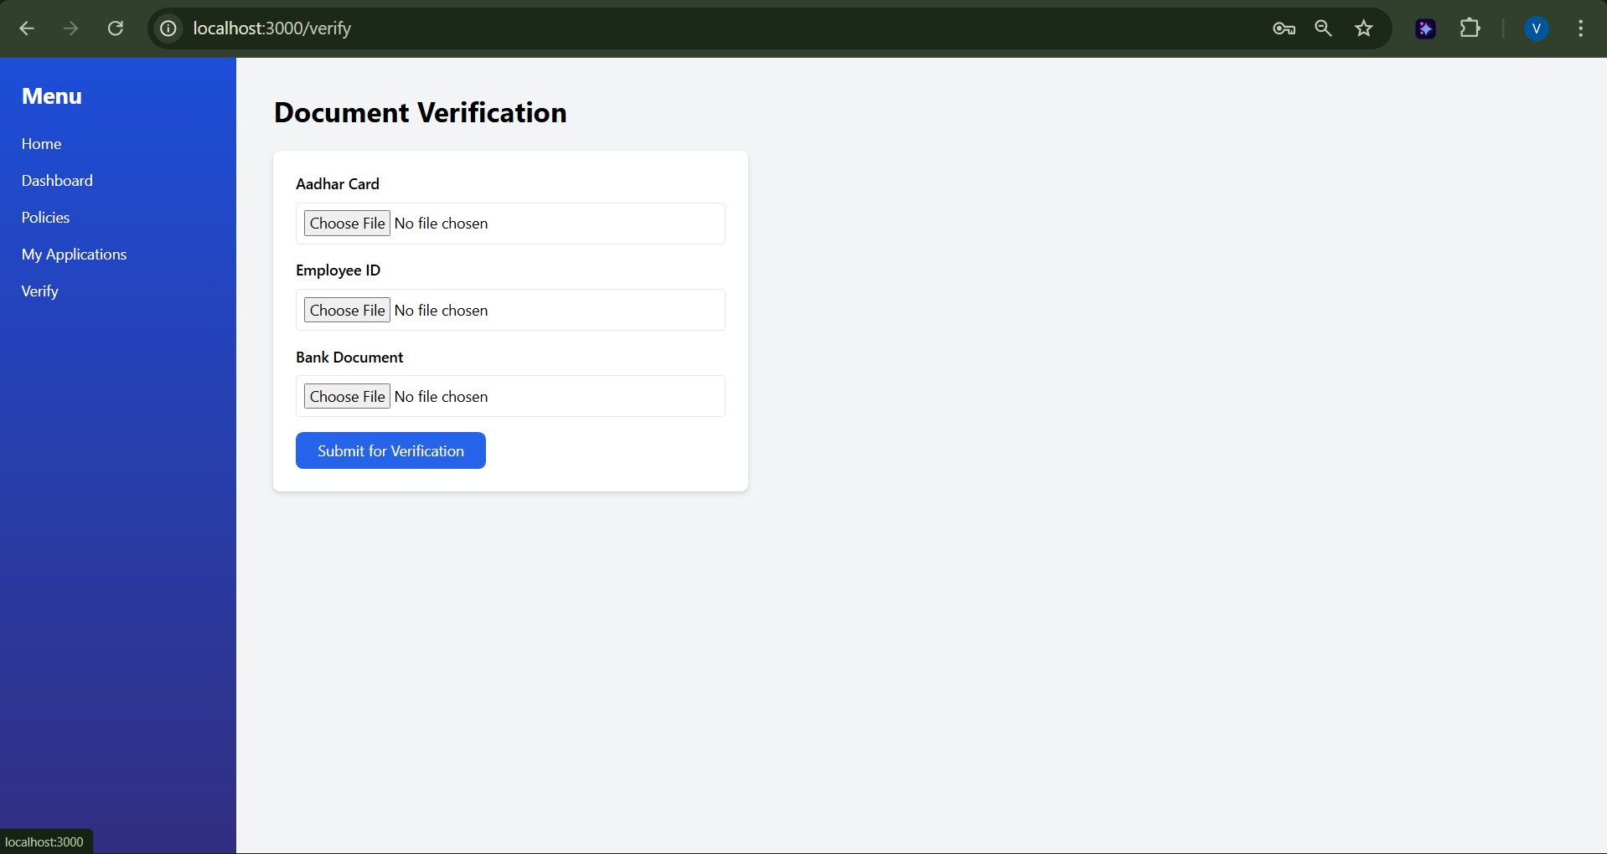
Verification Page

Slide 18
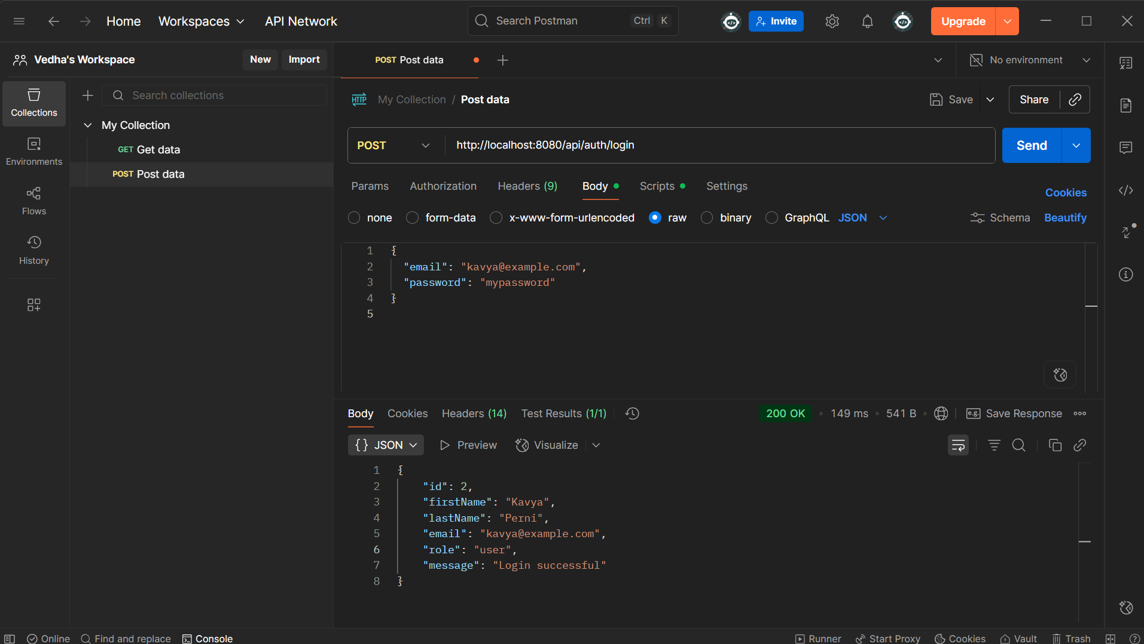
Testing APIs

Slide 19
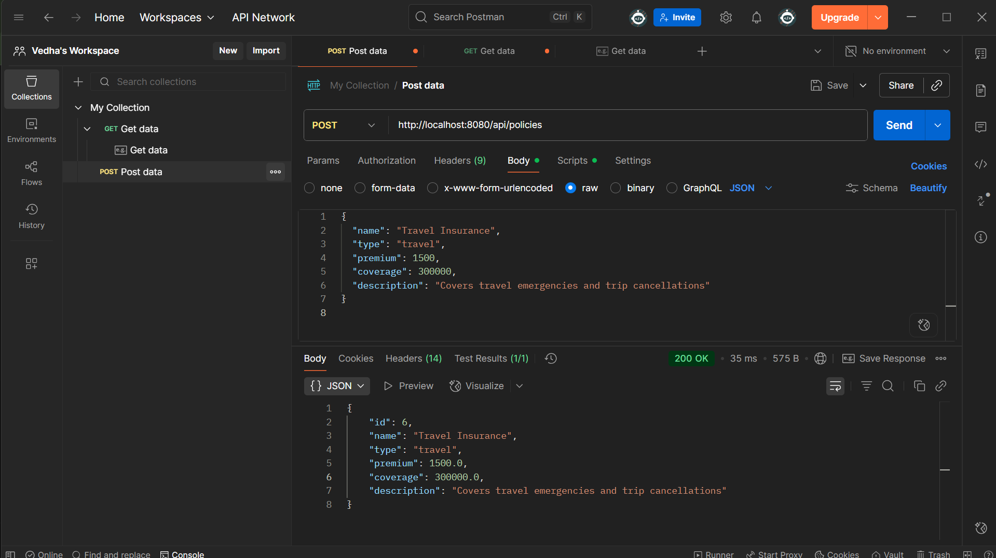

Slide 20
Acknowledgements
Special thanks to Infosys for providing this invaluable internship opportunity. Grateful to my mentors and teammates for their continuous support, guidance, and encouragement throughout this journey. This experience has been instrumental in shaping my professional development and technical expertise.

